Slide 1
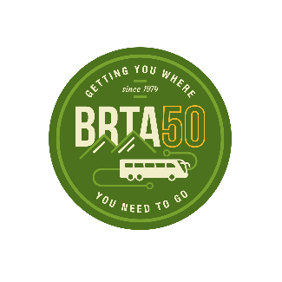
Berkshire Regional Transit Authority
FY2026 YEAR IN REVIEW
A year of record ridership, reliable service, and new regional connections.
SINCE 1974
Getting You Where You Need to Go
July 1, 2025 – June 30, 2026
www.berkshirerta.com

Slide 2
A Strong Year for Public Transit in the Berkshires
YEAR AT A GLANCE
Ridership grew across every service in FY2026 while on-time performance improved and safety reached its best level in years.
666,129
65,315
83.8%
952
Fixed-Route Passenger Trips
Paratransit Trips Provided
Fixed-Route On-Time
Link 413 Regional Riders
▲ 8.6% vs FY2025
▲ 12.1% vs FY2025
▲ from 82.1% in FY2025
New 3-region service
Source: BRTA FY2026 Year-to-Date Performance Reports

Slide 3
Ridership Keeps Climbing
FIXED-ROUTE SERVICE
+24%
growth over two years
2,156
Avg. riders per day up from 1,745 in FY2024
666,129
Total passenger trips up from 539,225 in FY2024
Source: BRTA FY2026 Fixed Route Performance Report

Slide 4
Paratransit Ridership by Year
PARATRANSIT SERVICE
+18%
growth over two years
211
Avg. riders per day up from 179 in FY2024
65,315
Total passenger trips up from 55,220 in FY2024
Source: BRTA FY2026 Paratransit Ridership Report

Slide 5
The Region's Busiest Routes
WHERE RIDERS GO
All twelve fixed routes across Berkshire County, ranked by annual ridership. Routes 1 and 34 alone carry nearly half of all trips.
Source: BRTA FY2026 Ridership & Cancellation Report

Slide 6
Scheduled Trips by Route
SERVICE DELIVERED
BRTA scheduled 84,312 trips across twelve routes in FY2026 and operated about 80,856 after 3,456.5 cancellations.
Source: BRTA FY2026 Ridership & Cancellation Report

Slide 7
Cancellations by Route
SERVICE RELIABILITY
BRTA cancelled 3,457 trips in FY2026, a 4.1% system-wide rate. Routes 1, 2, and 921 accounted for well over half of all cancelled trips.
Source: BRTA FY2026 Ridership & Cancellation Report

Slide 8
Route Performance Summary
SERVICE SCORECARD
FY2026 ridership, scheduled trips, and cancellations for all twelve fixed routes, with system totals.
Route | Ridership | Trips | Cancellations | Rate
Route 1 | 176,123 | 9,729 | 760 | 7.81%
Route 34 | 127,147 | 9,729 | 290 | 2.98%
Route 2 | 76,305 | 8,597 | 758 | 8.82%
Route 12 | 67,836 | 7,413 | 48 | 0.65%
Route 3 | 59,102 | 7,930 | 221.5 | 2.79%
Route 4 | 40,214 | 4,274 | 57.5 | 1.35%
Route 5 | 34,215 | 7,826 | 31 | 0.40%
Route 21 | 30,235 | 5,660 | 301.5 | 5.33%
Route 11 | 23,383 | 8,542 | 117 | 1.37%
Route 15 | 15,255 | 9,264 | 124 | 1.34%
Route 921 | 12,973 | 4,320 | 623 | 14.42%
Route 14 | 3,321 | 1,028 | 125 | 12.16%
Unassigned/Other | 20 | — | — | —
Total | 666,129 | 84,312 | 3,456.5 | 4.10%
Source: BRTA FY2026 Ridership & Cancellation Report

Slide 9
Reliable, Safe, and Well-Maintained
QUALITY & SAFETY
83.8%
95.9%
3,444
On-time performance
Scheduled trips operated
Mobility devices carried
within 5 min of schedule
4.1% cancellation rate
on fixed-route buses
100%
0.74
84,312
Preventive maintenance
Customers per revenue mile
One-way trips scheduled
completed on time
up from 0.69 in FY2025
across 309 service days
Source: BRTA FY2026 Fixed Route Performance Report

Slide 10
Door-to-Door Rides for Eligible Riders
PARATRANSIT SERVICE
BRTA's accessible paratransit service grew again this year, delivering dependable, on-time rides for riders across the county.
On-time pick-ups
Monthly ridership: FY2026 vs FY2025
90.3%
97.5%
of ADA/Non-ADA demand-response trips were ADA trips; excludes COA
8,228
Mobility devices (paratransit)
5,443
Avg. trips per month
Total: 65,315 trips in FY2026, up from 58,264 in FY2025.

Slide 11
Link 413: Connecting the Region
NEW THIS YEAR
Launched January 28, 2026
Link 413 is a new connective service linking three regional transit authorities — BRTA, FRTA, and PVTA — across Pittsfield, North Adams, Greenfield, and Northampton.
Riders per month — growing steadily
Most popular routes (share of riders)
62%
Route 904 Pittsfield ↔ Northampton
33%
Route 903 North Adams ↔ Greenfield
5%
Route 901 Pittsfield ↔ North Adams
952 total riders in FY2026 • Full route maps and schedules at berkshirerta.gov/link413

Slide 12
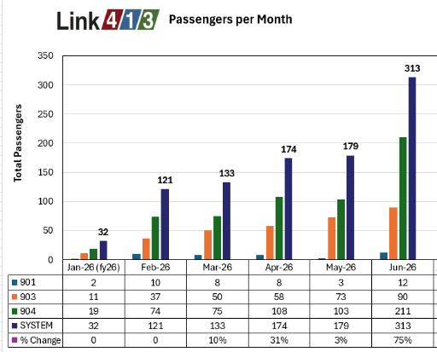
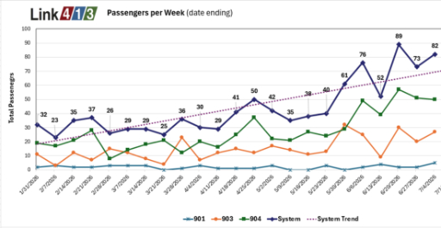
Passengers by Month and Week
LINK 413 RIDERSHIP
Ridership has climbed steadily since the January 2026 launch, reaching 313 riders in June.
952 total riders in FY2026 • Full route maps and schedules at berkshirerta.gov/link413

Slide 13
Getting You Where You Need to Go
LOOKING AHEAD TO FY2027
TOTAL FY2026 RIDERSHIP
731,444
Fixed route + paratransit trips
With record ridership, strong reliability, and new regional links, BRTA is building a transit network the whole community can count on.
www.berkshirerta.com | (800) 292-BRTA | info@berkshirerta.gov

