Slide 1
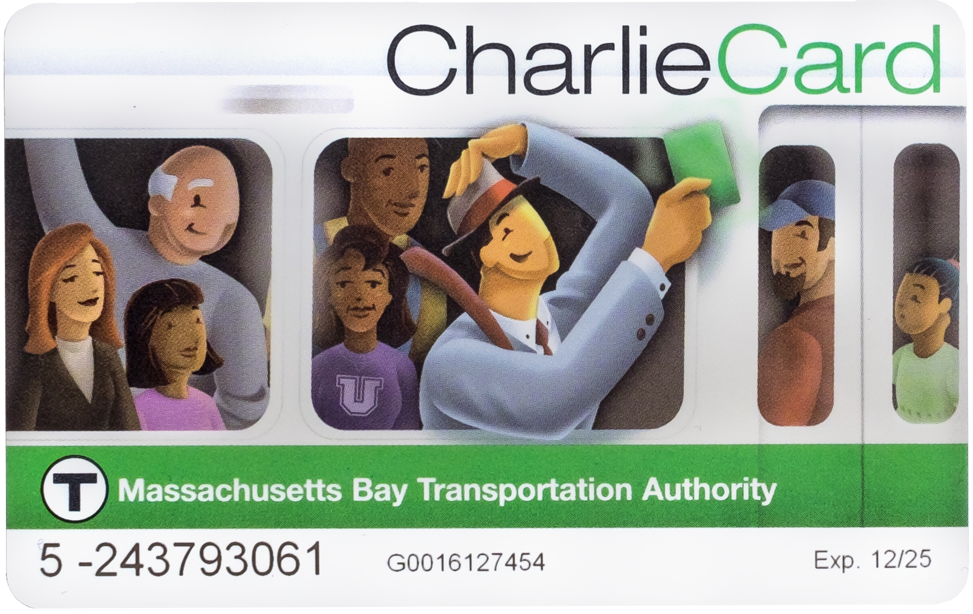
LAST Month to sell back your Charlie Card
SEPTEMBER 2026
Every Wednesday
2PM - 4:00PM
Customer Service will issue refunds ONLY during dates/times.
BRTA can only refund “STORED VALUE”
BUS PASSES ARE NON-REFUNDABLE
Get back CASH $$$$$

